Slide 1

HIGH SPEED CAMERA using a MOBILE MANIPULATOR
AAQIB BARODAWALA - 119348710
SANDEEP THALAPANANE - 119402535

Slide 2
index
Problem & Motivation
Steps Involved
Robot Design
Forward Kinematics
Inverse Kinematics
Simulation
Challenges
Individual Contributions
Conclusion
References

Slide 3
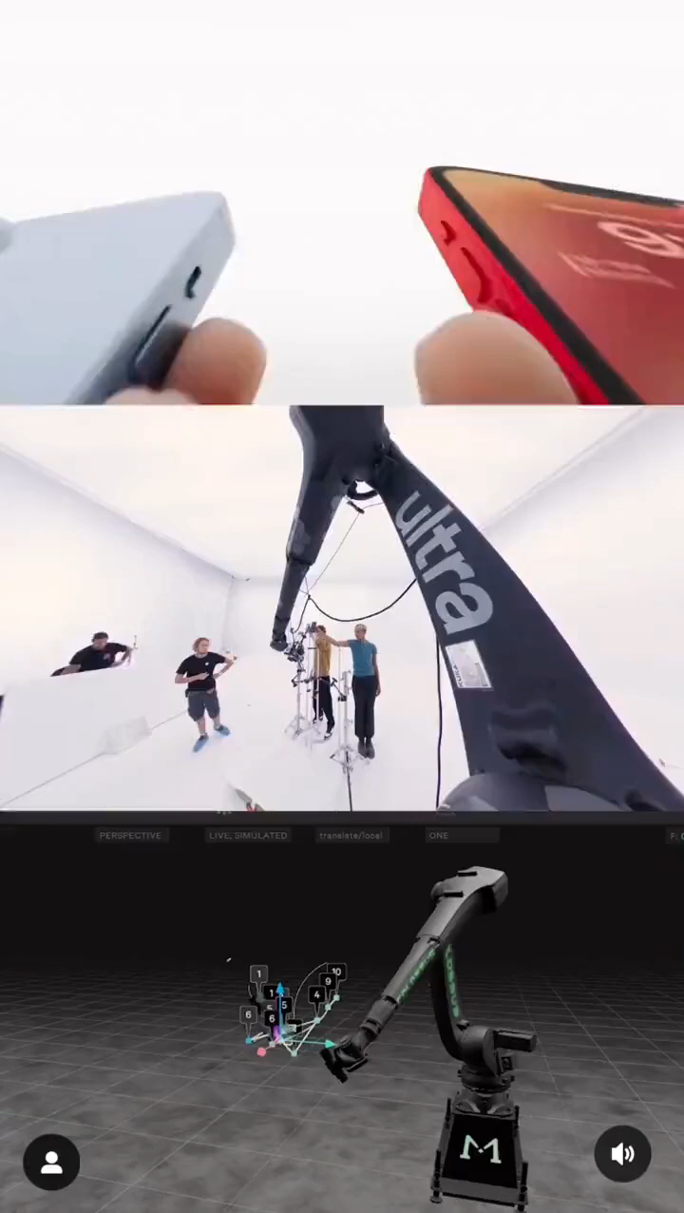
Problem & MOTIVATION
There are some complex camera movements which cannot be achieved by a cinematographer/director using hands or even stabilizing gimbals which are used by many studios for acquiring professional shots.
A High-speed Robotic Camera can achieve such cinematic shots by programming the speed and providing an input to reach the desired target and orientation.
Such robotic arm configurations can go from one position to another in a fraction of a second.
The parameters can be pre-programmed and hence the robot can operate on its own.
Recently, Apple INC. also shot their advertisement for their new iPhone 14 phone using a robotic cam and achieved very precise shots.

Slide 4
STEPS involved
1
Design and assemble a mobile platform for the UR3 manipulator in SolidWorks and exporting to URDF
2
Calculation and validation of Forward Kinematics and Inverse Kinematics of the manipulator
3
Build the ROS Package with controllers and writing scripts for the entire assembly to move the robot
4
Simulate and Visualize using Gazebo and RViz

Slide 5
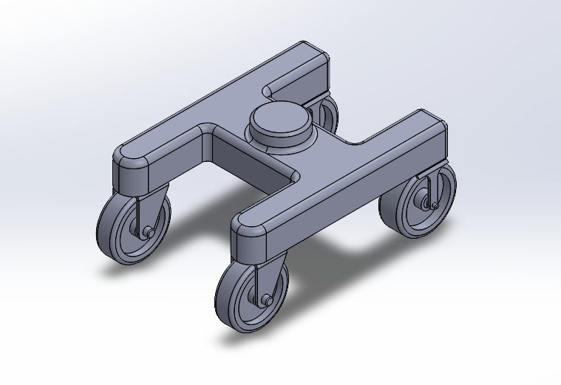
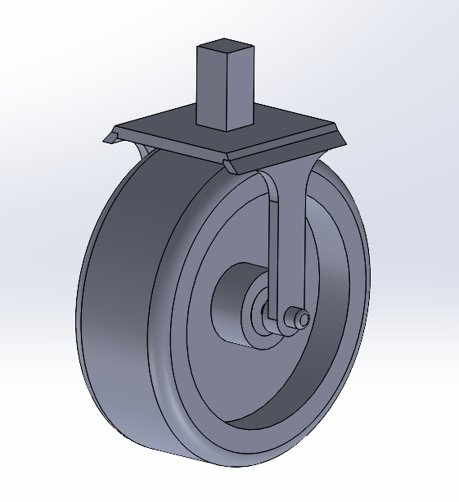
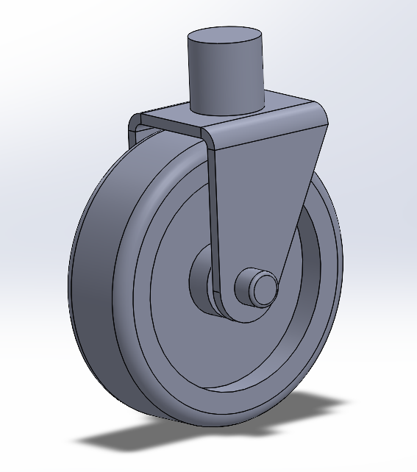
Robot design
Rear wheel Assembly
Front wheel Assembly
Chassis

Slide 6
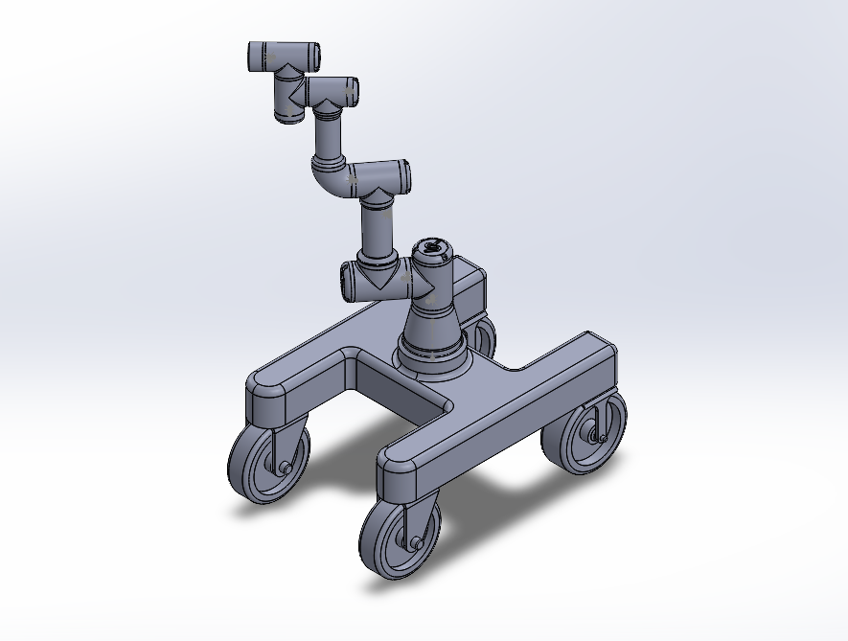
Mobile Manipulator Assembly

Slide 7
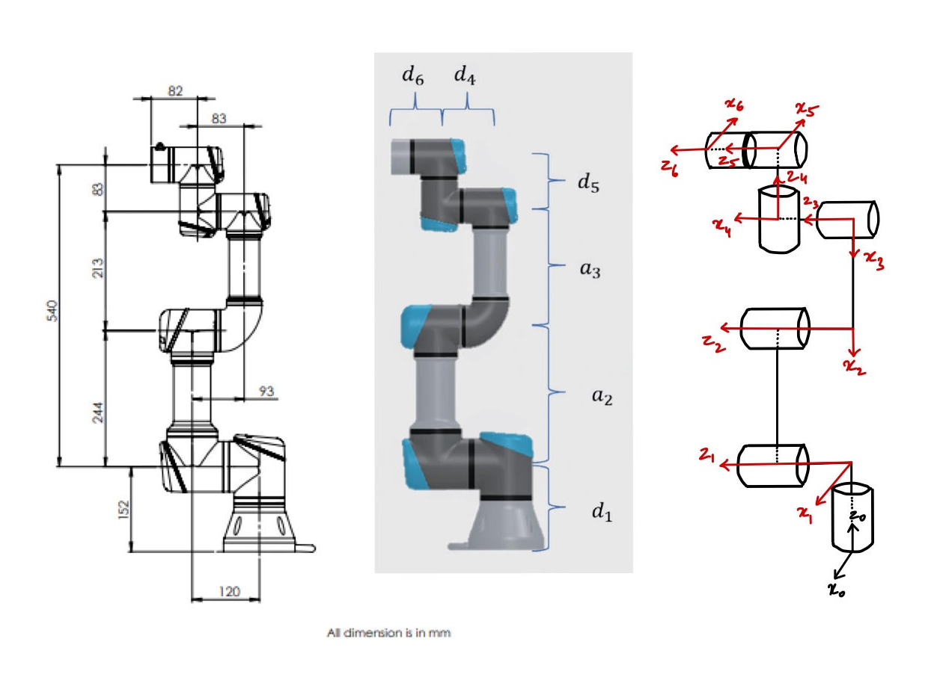
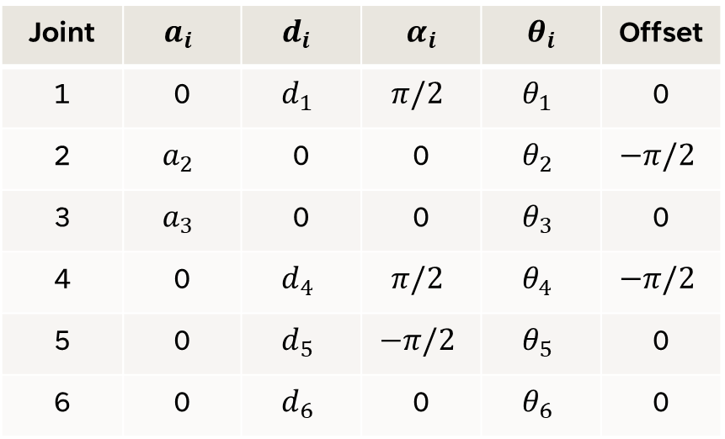
FORWARD KINEMATICS
DH Table
Joint | $$a_{i}$$ | $$d_{i}$$ | $$α_{i}$$ | $$θ_{i}$$ | Offset
1 | 0 | $$d_{1}$$ | $$π/2$$ | $$θ_{1}$$ | 0
2 | $$a_{2}$$ | 0 | 0 | $$θ_{2}$$ | $$−π/2$$
3 | $$a_{3}$$ | 0 | 0 | $$θ_{3}$$ | 0
4 | 0 | $$d_{4}$$ | $$π/2$$ | $$θ_{4}$$ | $$−π/2$$
5 | 0 | $$d_{5}$$ | $$−π/2$$ | $$θ_{5}$$ | 0
6 | 0 | $$d_{6}$$ | 0 | $$θ_{6}$$ | 0

Slide 8
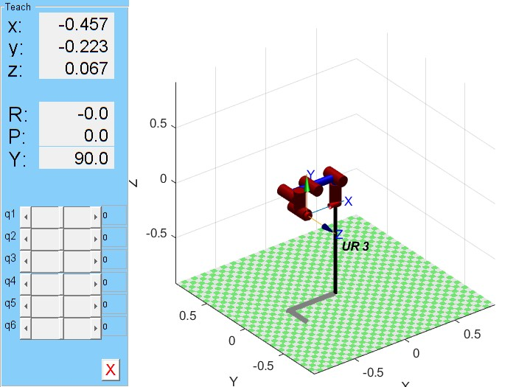
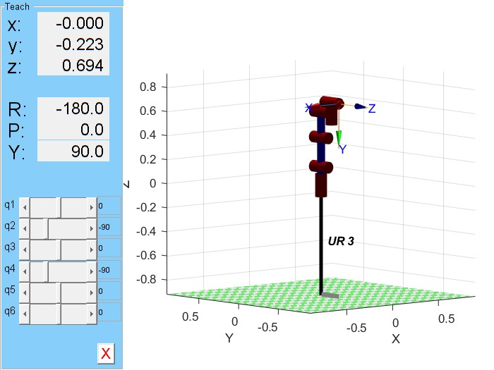
Peter Corke’s MATLAB Toolbox

Slide 9
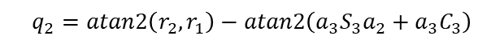
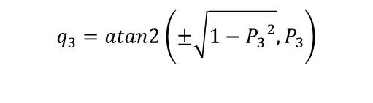
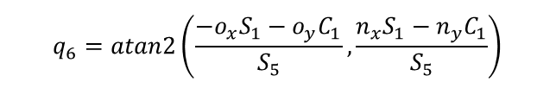
INVERSE KINEMATICS
$$q_{1}=atan2\left.\left(d_{4}, ±\right.\left.\sqrt{{\left.\left(d_{6}a_{y}−p_{y}\right.\right)}^{2}+{\left.\left(p_{x}−d_{6}a_{x}\right.\right)}^{2}−{d_{4}}^{2}}\right.\right)−atan2\left.\left(d_{6}a_{y}−p_{y},p_{x}−d_{6}a_{x}\right.\right)$$
$$q_{5}=atan2\left(±\sqrt{{\left.\left(n_{x}S_{1}−n_{y}C_{1}\right.\right)}^{2}+{\left.\left(o_{x}S_{1}−o_{y}C_{1}\right.\right)}^{2}}, a_{x}S_{1}−a_{y}C_{1}\right)$$
$$q_{6}=atan2\left(\frac{−o_{x}S_{1}−o_{y}C_{1}}{S_{5}},\frac{n_{x}S_{1}−n_{y}C_{1}}{S_{5}}\right)$$
$$q_{3}=atan2\left(±\sqrt{1−{P_{3}}^{2}},P_{3}\right)$$
$$q_{2}=atan2\left(r_{2},r_{1}\right)−atan2\left(a_{3}S_{3}a_{2}+a_{3}C_{3}\right)$$
$$q_{4}=atan2\left(n_{2}C_{5}c_{6}−a_{z}S_{5}−O_{2}C_{5}S_{6},o_{z}C_{6}+n_{z}S_{6}\right)−q_{2}−q_{3}$$

Slide 10
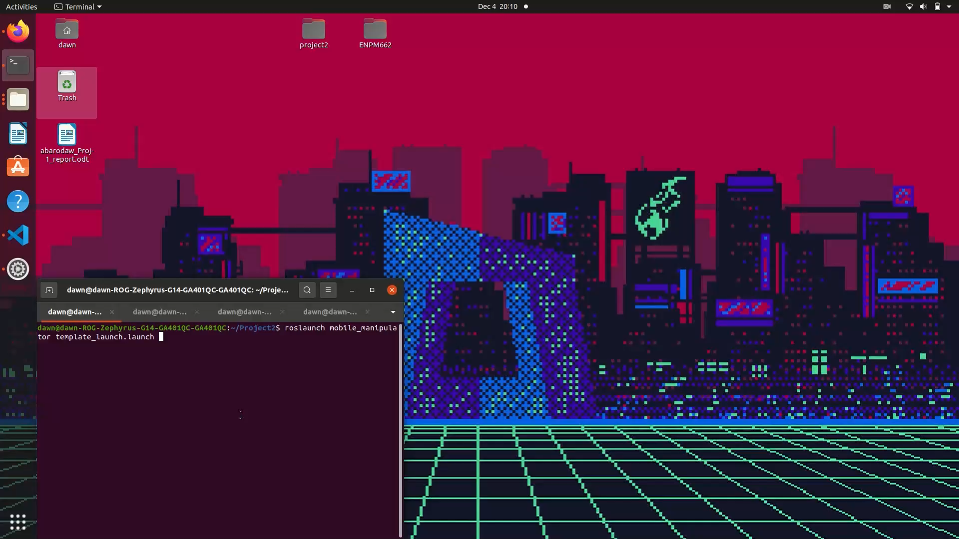
simulation

Slide 11
CHALLENGES FACED
Design
1. Choosing an optimal design for the platform of the mobile manipulator.
2. Exporting to URDF and joint axes definition.
ROS & Visualization
1. Toppling of robot due to misalignment of center of mass of the mobile manipulator.
2. Choosing appropriate controllers for the smooth movement of arm joints.
3. Choosing the right position and orientation of the camera for the perfect view at the end effector.

Slide 12
INDIVIDUAL CONTRIBUTIONS
AAQIB
SANDEEP
BOTH
Mobile platform design
Forward kinematics
Built ROS packages
Integrated camera to the end effector
Defined Joint axes, origin and URDF export
Inverse kinematics
Added controllers for the robot arm
Python script for moving the mobile robot
Gazebo and RViz visualization.
Correct positioning and movement of the arm.

Slide 13
CONCLUSION
With the help of mobile robotic camera, we can easily program the movements and achieve desired complex camera movements.
By adding the platform, we can transport the robotic arm with ease.

Slide 14
references
UR3 CAD Model - https://www.traceparts.com/en/product/universal-robots-as-ur3-robot?Product=10-06032017-106400
iPhone 14 ad BTS - https://youtube.com/shorts/hODFKkZD_nA?feature=share
UR3 Image - https://www.semanticscholar.org/paper/Multiple-configurations-for-puncturing-robot-Abdelaziz-Luo/82bb0af4e8b5ea131aabc36b65dafeabd55c97aa

Slide 15
THANK YOU

